Slide 1
Survivor Resource Center
Final Presentation
Consulting Project for Marcie Sheridan, Executive Director
Course: STAT 427 Statistical Consulting
Group Members:
Joe Li, Jinhong Zhu, Kexin Wang, Weijia He, Xiaoshan Huang

Slide 2
Introduction
Exploratary Data Analysis
Modeling
Selected Model and Shiny App
Conclusion and Recommendation
Content

Slide 3
Introduction

Slide 4

Client
● Marcie Sheridan:
Executive Director at Survivor Resource Center
● Survivor Resource Center(SRC):
A non-profit organization that provides support for survivors of violence and
trauma

Slide 5
Project purpose
Goal:
1) Identify key factors driving temporal and regional variations in sexual crime
2) Analyze the changes in sexual crimes in selected counties in Illinois
Significance：
Provide data-driven support for SRC's resource allocation and intervention strategies

Slide 6
Dataset
Problems:
The lack of a clean dataset
Inconsistencies and missing values across sources
Monthly dataset from 2021 to 2024

Slide 7
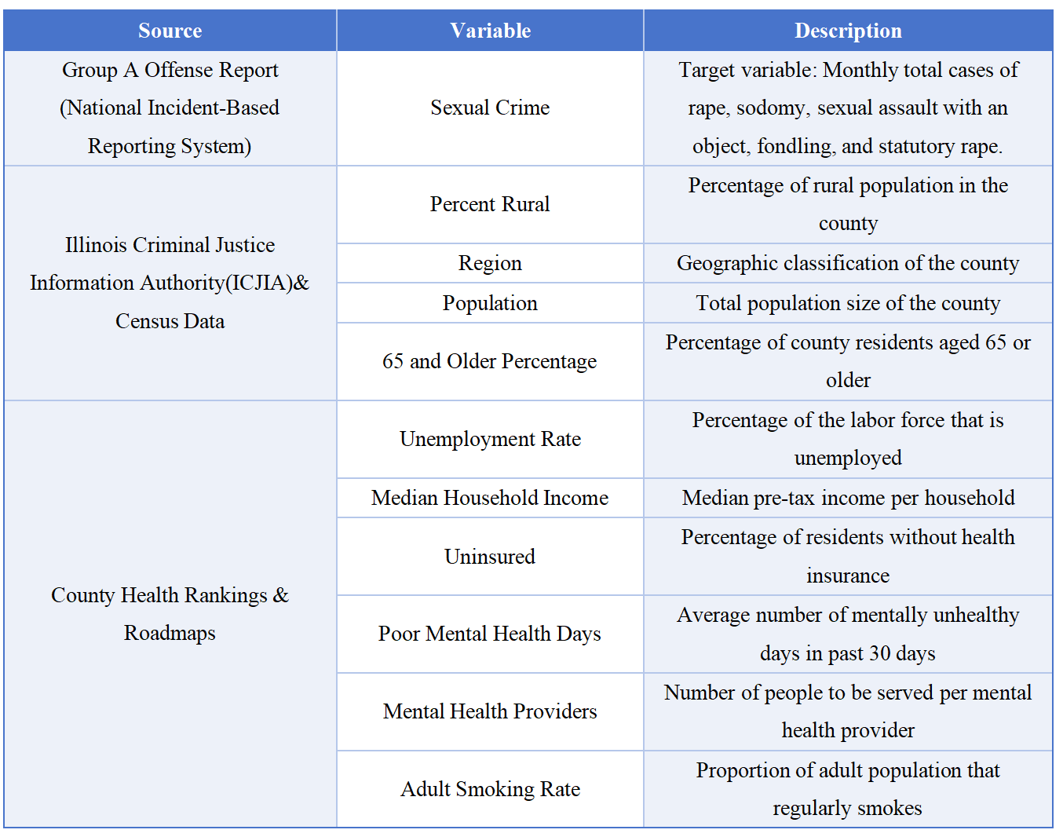
Dataset
Sexual Crime
Demographic and
geographic variables
(For Clustering)
Public health and socioeconomic variables

Slide 8
Exploratary Data Analysis

Slide 9
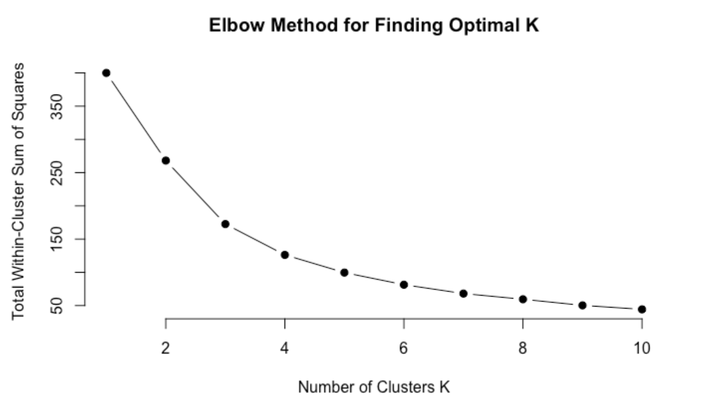
Clustering
Rural Percentage | Region | Median Household Income | Population
County:
DeKalb, LaSalle, McLean,
Madison, Peoria, Rock Island,
St. Clair, Sangamon, Tazewell,
Winnebago, Champaign, Vermilion

Slide 10
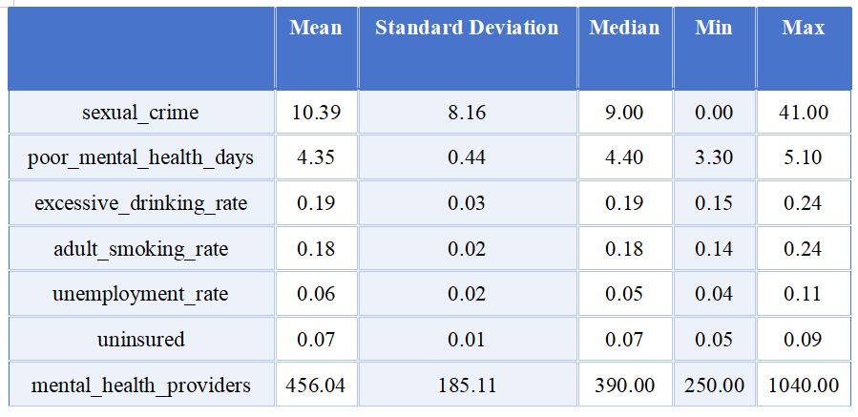
Basic Analysis

Slide 11
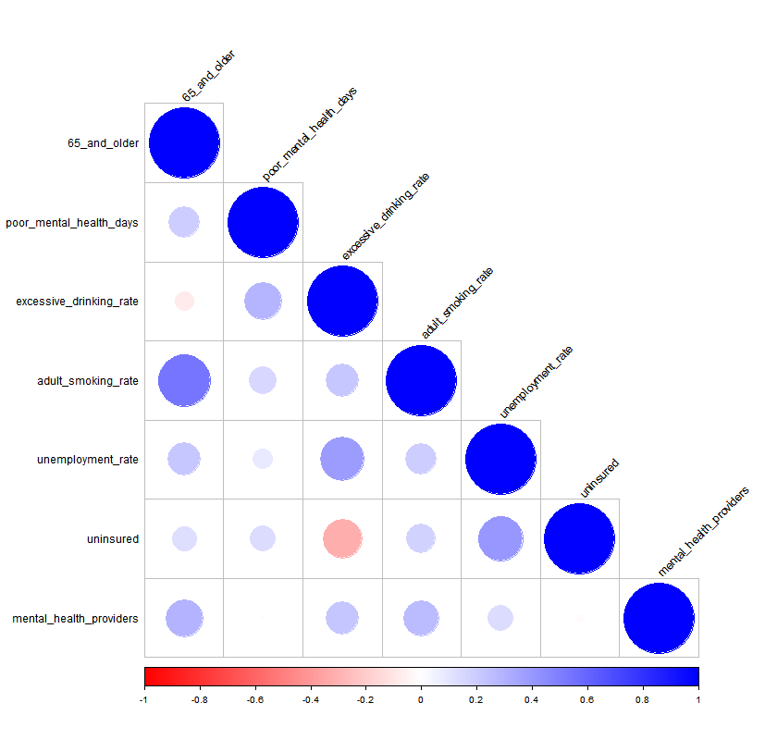
Correlation Plot

Slide 12
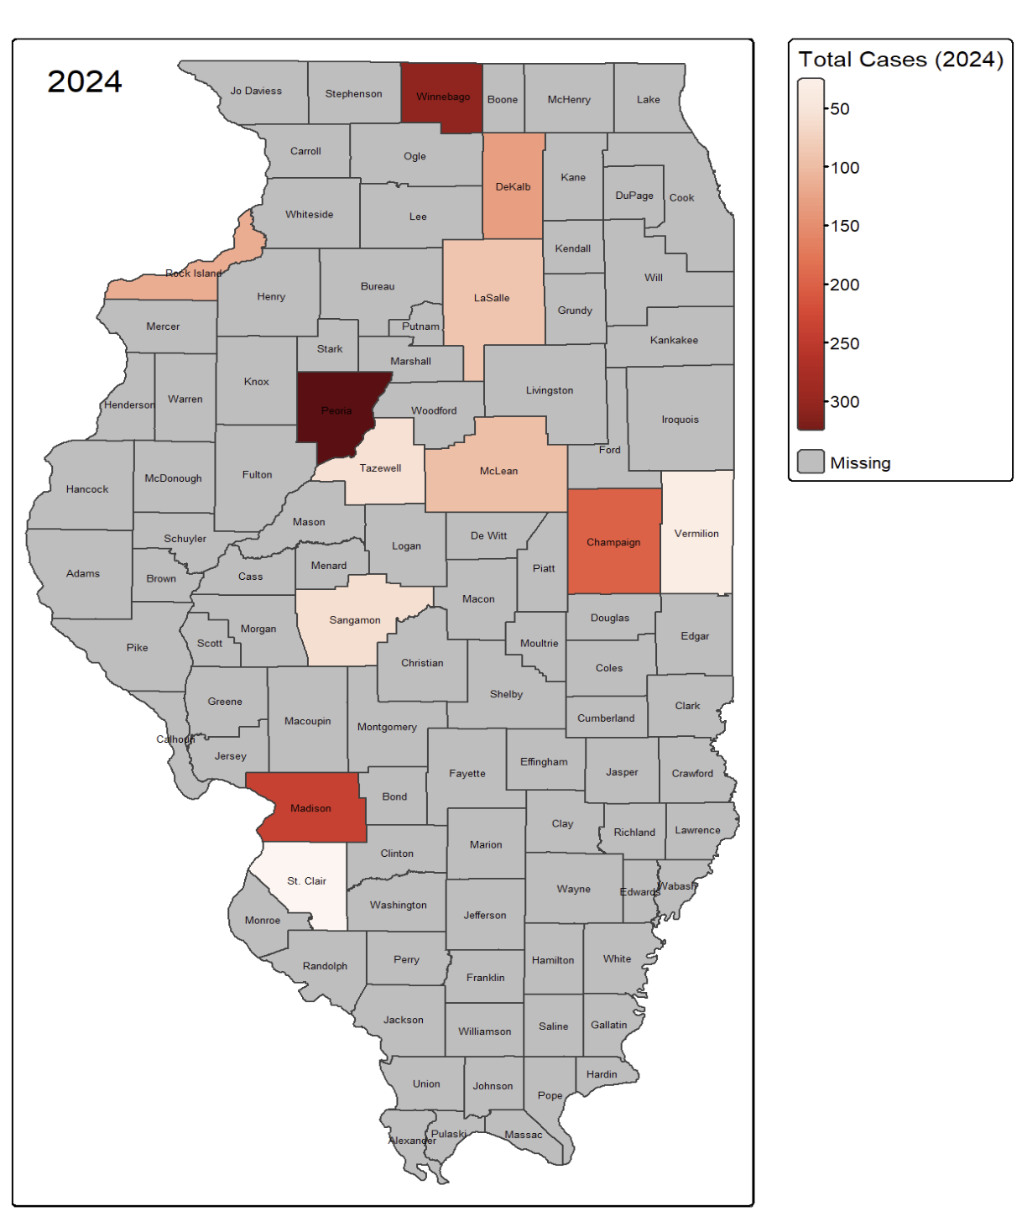
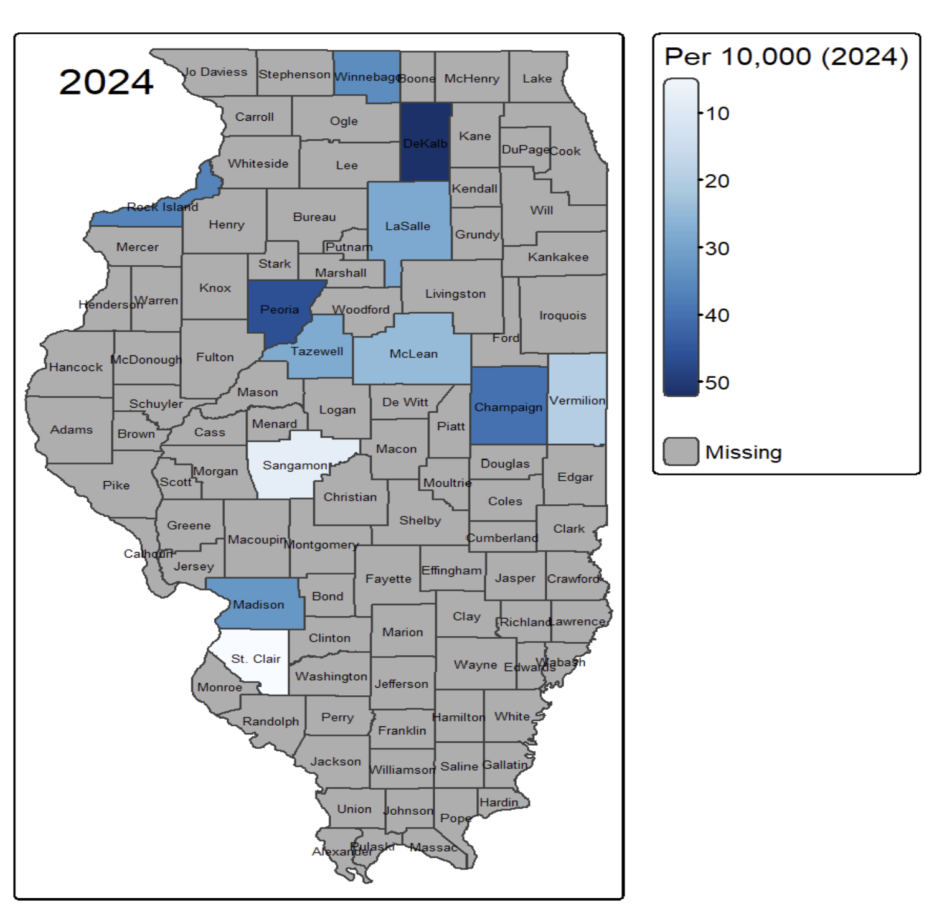
Distribution Map
Distribution Map of Total Cases in 2024
Champaign, Madison, and Winnebago
Distribution Map Per 10,000 in 2024
Dekalb, Champaign, and Peoria

Slide 13
Modeling Attempt

Slide 14
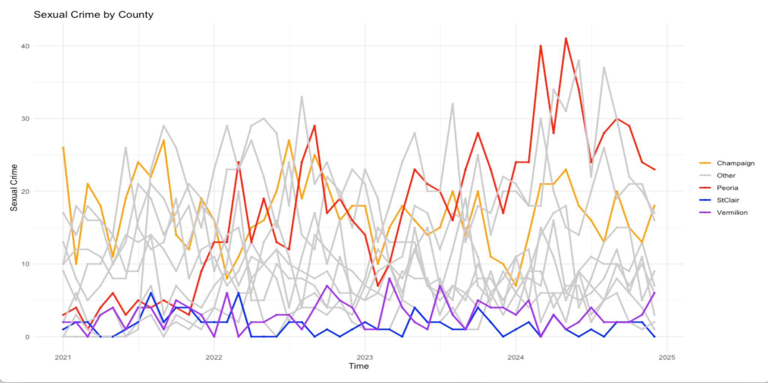
Time Series Plot

Slide 15
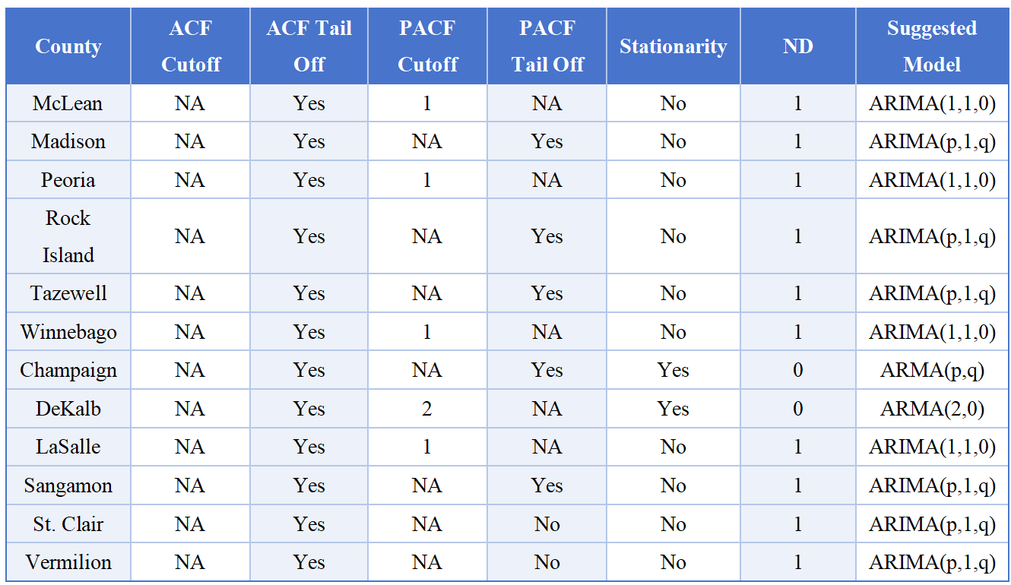
Time Series Analysis
Most counties exhibit nonstationarity
Serial dependence and trend exist

Slide 16
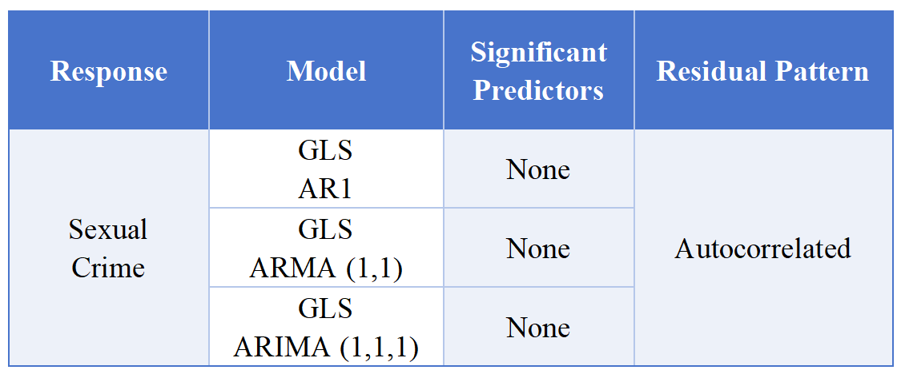
Initial Modeling Attempt: Generalized Least Squares (GLS)
Problems:
No predictors are statistically significant
— Do not provide meaningful innformation
Residuals autocorrelated
— Violating model assumptions

Slide 17
Model Improvements

Slide 18
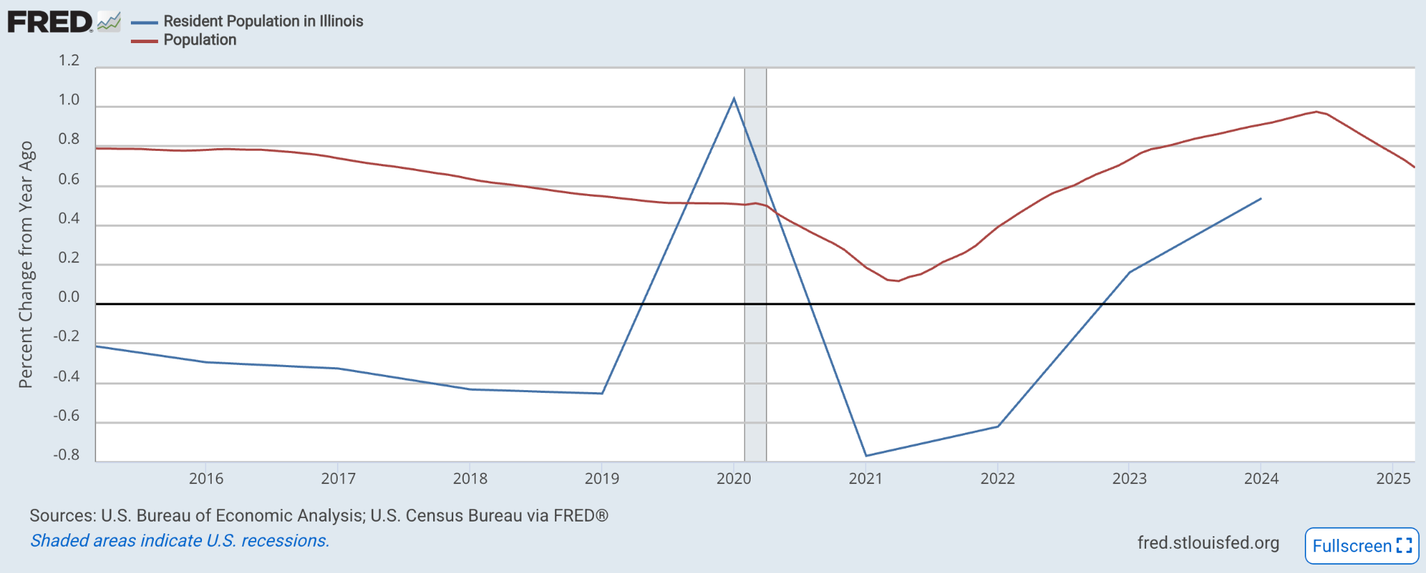
Disaggregating predictors to monthly using new dataset

Slide 19
Extends GLS to GEE to account for correlation within clustered or longitudinal data
Clustered — Grouped by counties
Longitudinal — Collected over 48 months for each county
Generalized Estimating Equations Overview

Slide 20
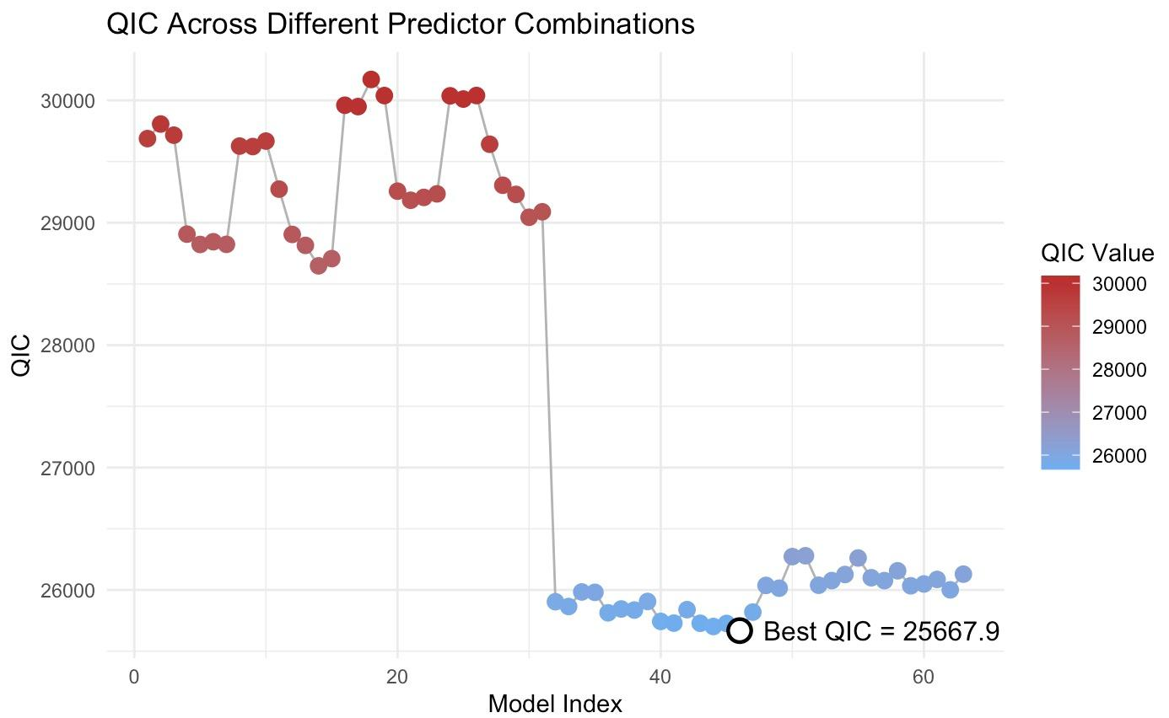
Combinations over all predictors for best subset
2⁶ - 1 = 63 combinations
(Excluding null model)
Big drop represents inclusion of most important factor
(Mental Health Providers)

Slide 21
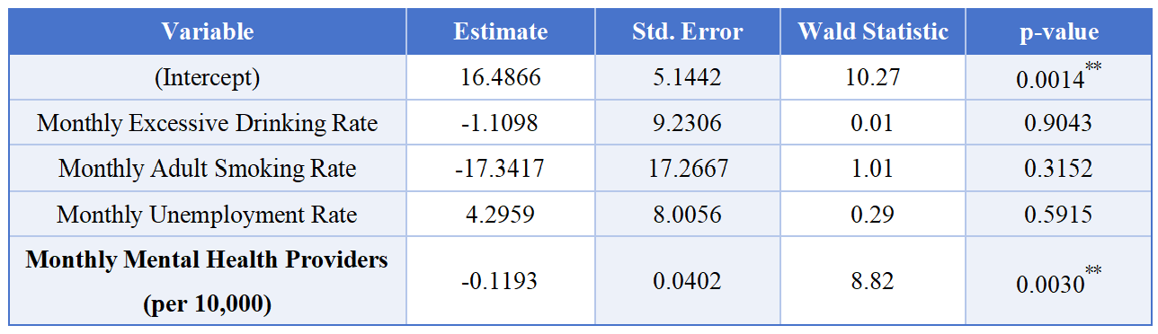
Final Model
In best predictor subset:
Lowest QIC (25667.9) over combinations
AR(1) coefficient of 0.9748
Mental Health Providers is the most essential predictor

Slide 22
Conclusion

Slide 23

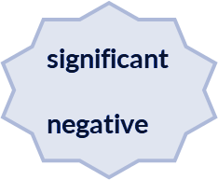


Properties of final model
Variables:
Excessive drinking rate
mental health providers per 10000 people
adult smoking rate
unemployment rate

Slide 24
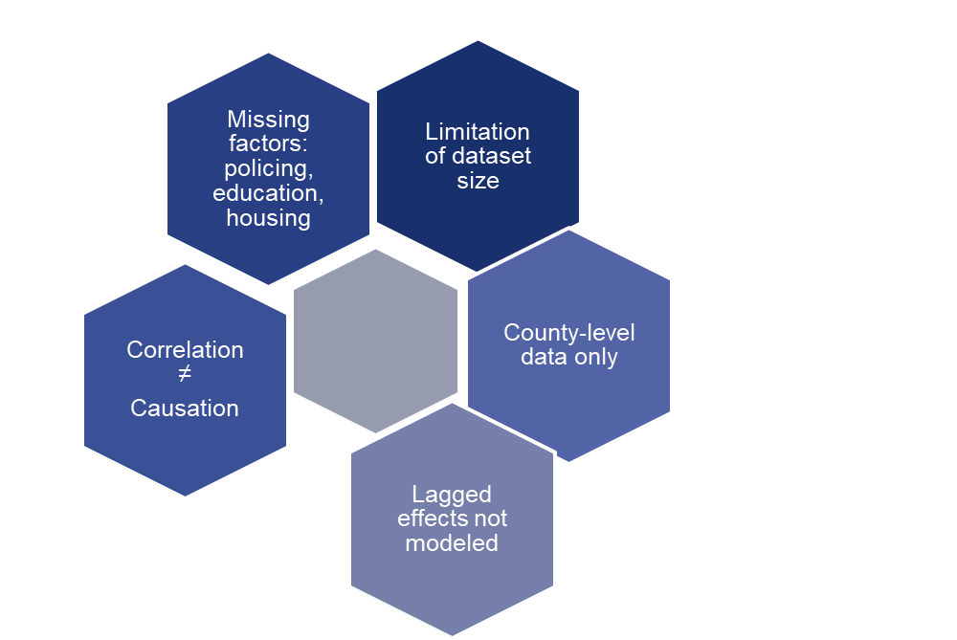
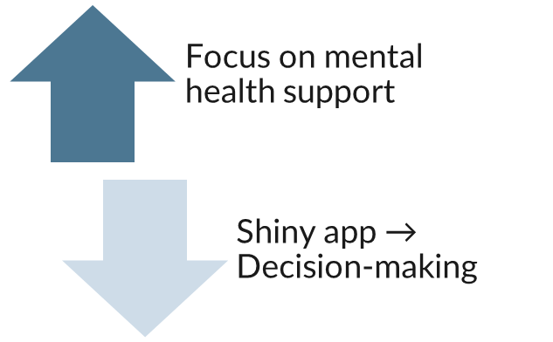
Limitations & Recommendations

Slide 25
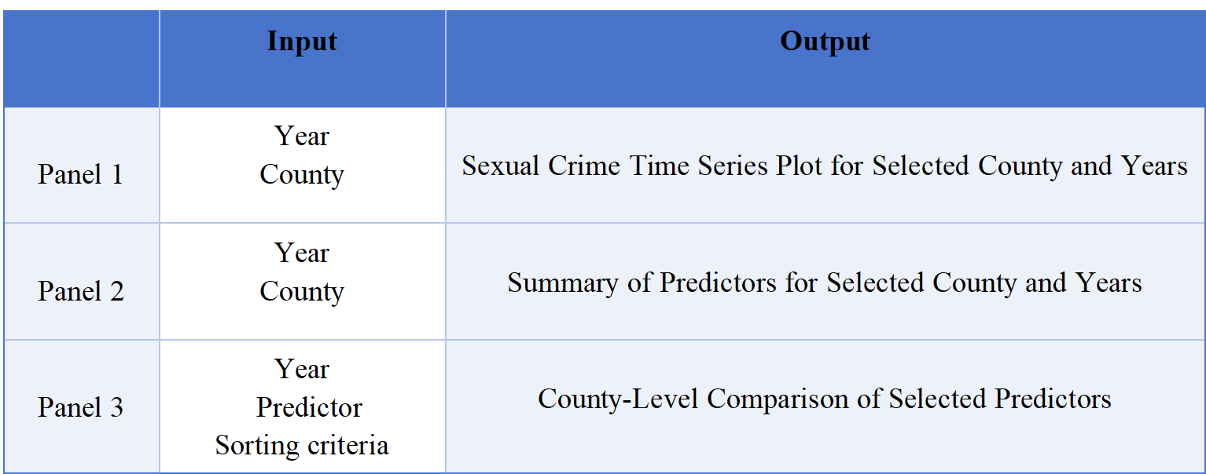
https://srcgroup.shinyapps.io/src_shiny/
Shiny Application

Slide 26
References
Aitken, A. C. (1935). On Least Squares and Linear Combinations of Observations. Proceedings of the Royal Society of Edinburgh, 55, 42–48.
County Health Rankings & Roadmaps. (2024). Frequent mental distress. University of Wisconsin Population Health Institute. https://www.countyhealthrankings.org/health-data/population-health-and-well-being/quality-of-life/mental-health/frequent-mental-distress
Hyndman, R. J., & Athanasopoulos, G. (2021). Forecasting: Principles and practice (3rd ed.). OTexts.
Illinois State Police. (n.d.). Crime in Illinois. Illinois Uniform Crime Reporting (I-UCR) Program. https://ilucr.nibrs.com/CrimePublication/CrimeinIllinois
Liang, K.-Y., & Zeger, S. L. (1986). Longitudinal data analysis using generalized linear models. Biometrika, 73(1), 13–22. https://doi.org/10.1093/biomet/73.1.13
U.S. Bureau of Economic Analysis, Population [POPTHM], retrieved from FRED, Federal Reserve Bank of St. Louis; https://fred.stlouisfed.org/series/POPTHM, April 29, 2025

Slide 27
Thank you !
Q & A

